Slide 1
Measures and calculated
columns
Measures and calculated
columns

Slide 2
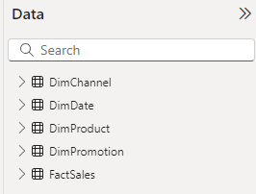
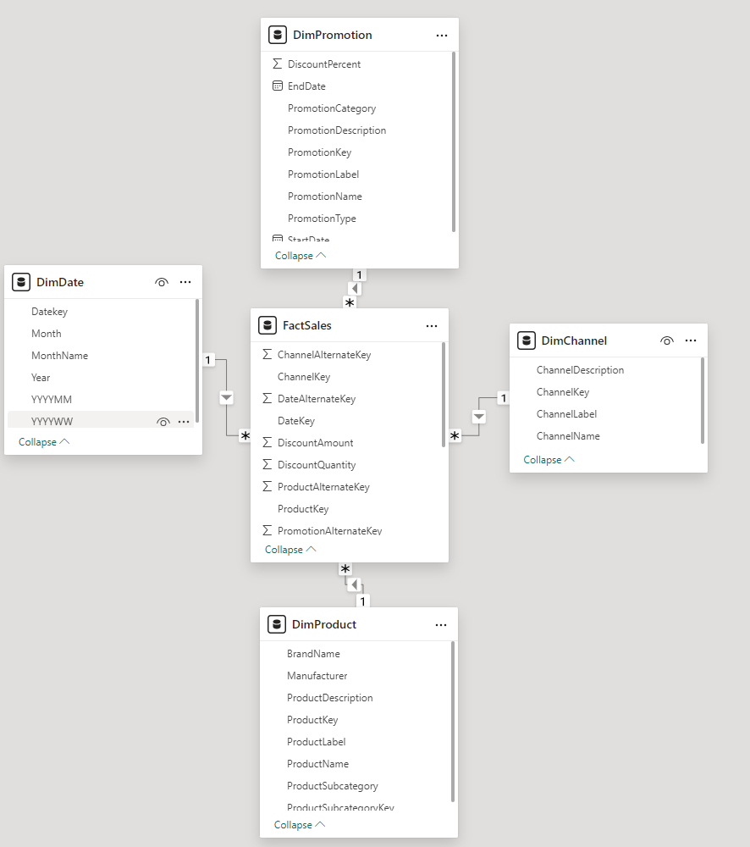
Measures and columns calculated
Note: This lab uses the FactSales032025.csv and DimDate.csv tables from resources \ CSVSources to demonstrate the difference between creating a calculated column and a measure.

Slide 3
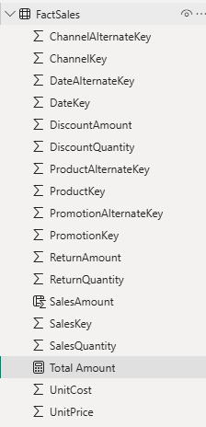
Measures and columns calculated
Create a column called SalesAmount = FactSales[ SalesQuantity ]*FactSales[ UnitPrice ]

Slide 4

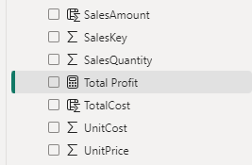
Measures and columns calculated
TotalProfit measure at the FactSales table level that calculates total profit:
Total Profit = SUM ( FactSales[ SalesAmount ] ) - SUMX ( FactSales , FactSales [ SalesQuantity ] * FactSales[ UnitCost ] )
Note the difference in using the SUM and SUMX functions to aggregate data.

Slide 5
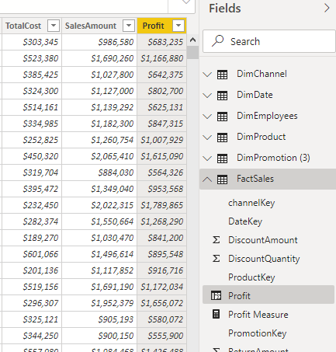
Measures and columns calculated
Note that the measure only takes into account aggregations. For example
Total Profit = SUM (FactSales[ SalesAmount ]) - SUMX ( FactSales,FactSales [ SalesQuantity ]*FactSales[ UnitCost ])

Slide 6
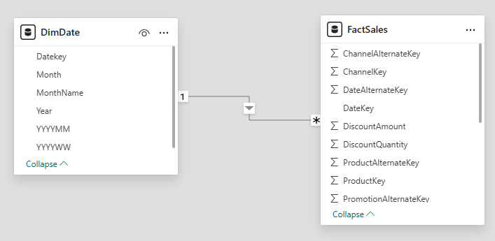
Measures and columns calculated
Note that the measure does not appear as a calculated column because the scope differs in the two cases.
Add the DimDate dimension from the DimDate.csv file and check the relationship between DimDate and FactSales

Slide 7
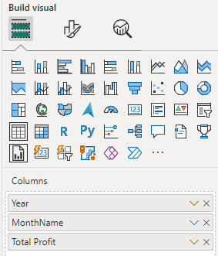
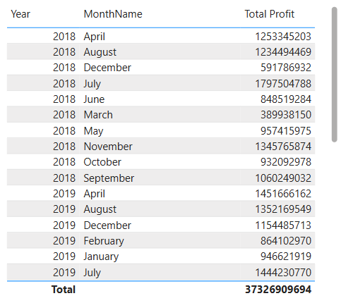
Measures and columns calculated
Go back to the scene, add a Table type visualization and add Year and MonthName respectively as well as Total Profit in the Columns parameter and observe the visualization change.

Slide 8
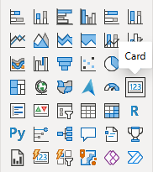
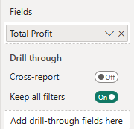
Measures and columns calculated
Add a Card visual and drag the Total Amount measurement at the Fields

Slide 9
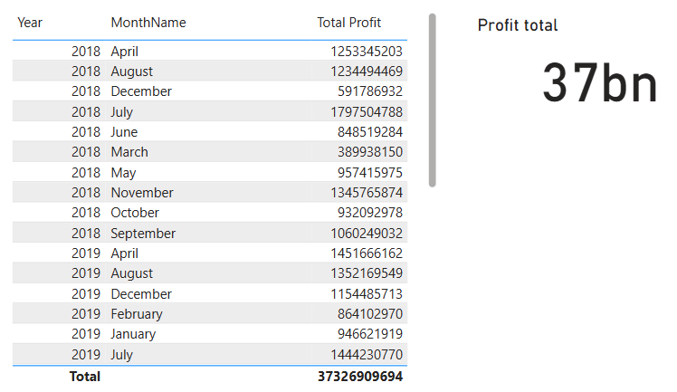
Measures and columns calculated
Observe the result

Slide 10
Thank you
Thank you

